Slide 1
Introduction to data science project
Analysis of meteorite landing sites
By:
Sindhu Rao (PES1201801704)
Sinduja Mullangi (PES1201801836)
Shubham Gupta (PES1201801295)

Slide 2

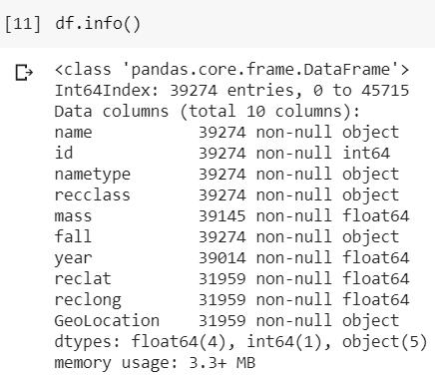
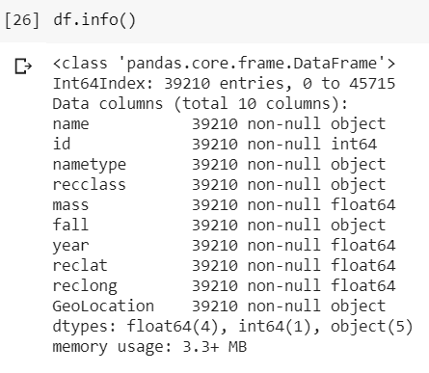
Data cleaning
Before
After
Comparison of columns values before and after cleaning NaNs / missing data

Slide 3
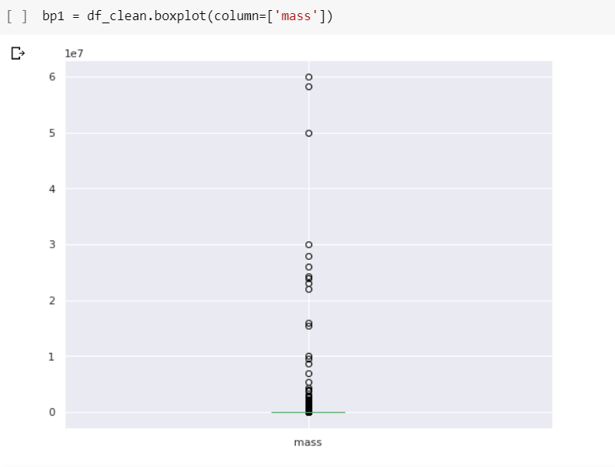
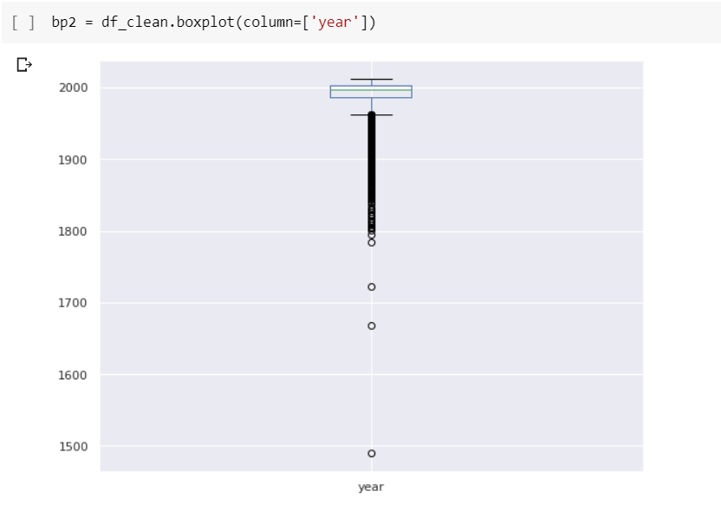
Data Normalization
We normalize, that is, make mean = 0 and variance = 1 for the mass and year column
Before normalization, we need to check for outliers.
Drop all rows with outlier values.
Boxplot representation of mass and year column
Before removing outliers in mass column
Before removing outliers in year column

Slide 4
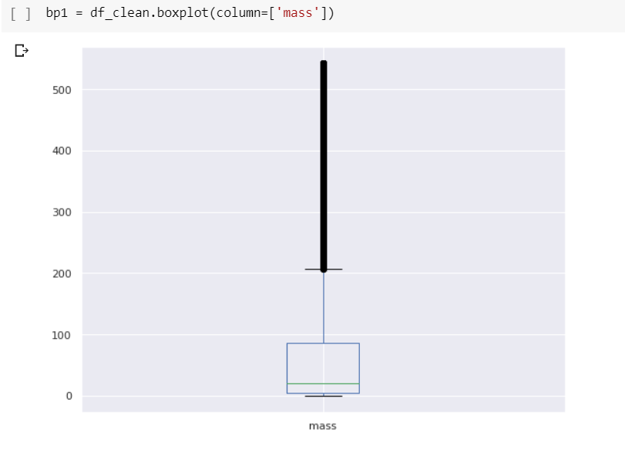
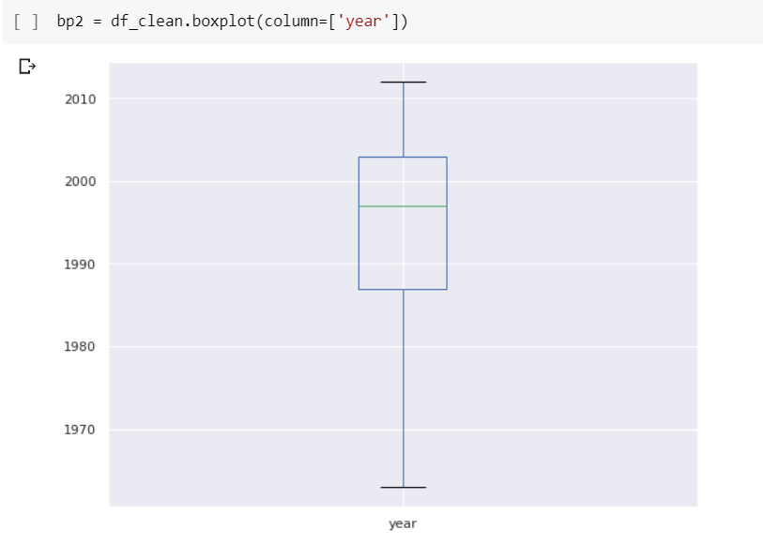
Distribution of data after removing outliers in respective columns
Mass
Year
Reasons to remove outliers:
Skewed distribution
Distribution curve is not symmetric

Slide 5

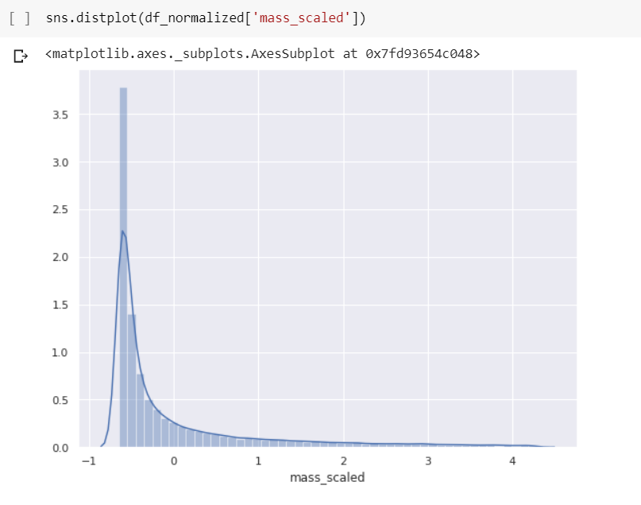
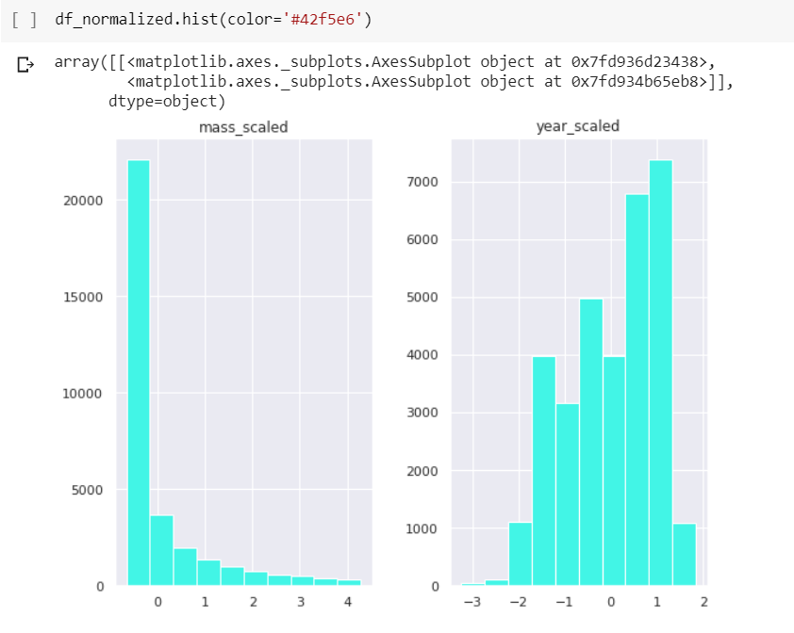
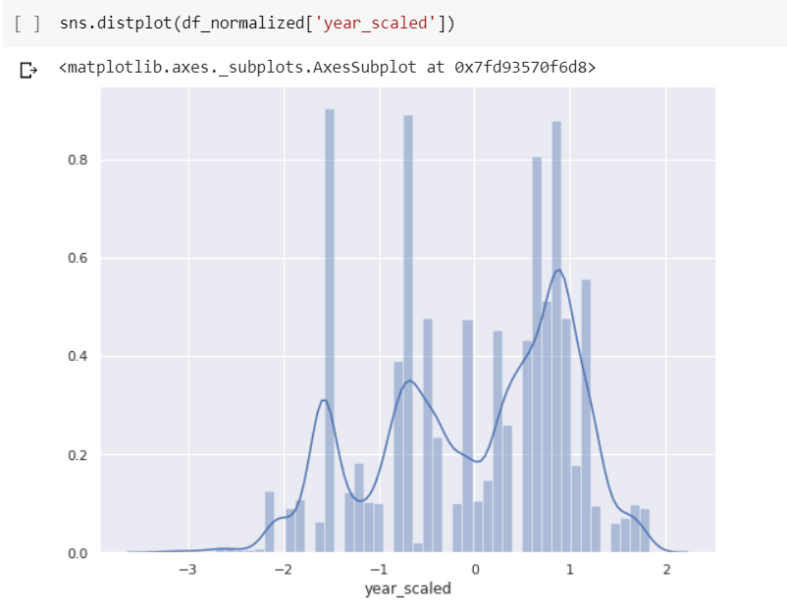
Graphs to check normalization of data

Slide 6
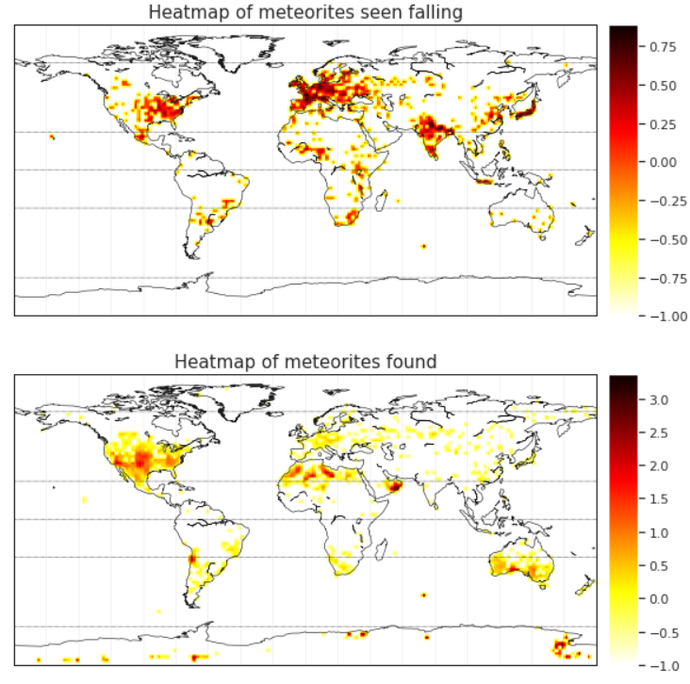
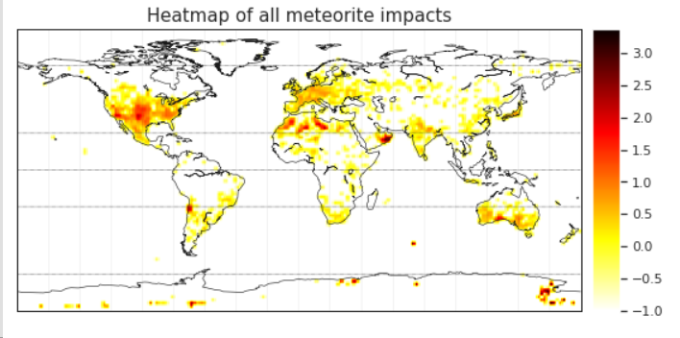
Visualizations
Geographic visualizations
From the heatmaps, we get:
Most of the meteorites seen falling are in East United States, Europe, India, Korea and Japan
Most of the meteorites found are in Central United States, Northern Africa, Sudan and Southern Australia

Slide 7
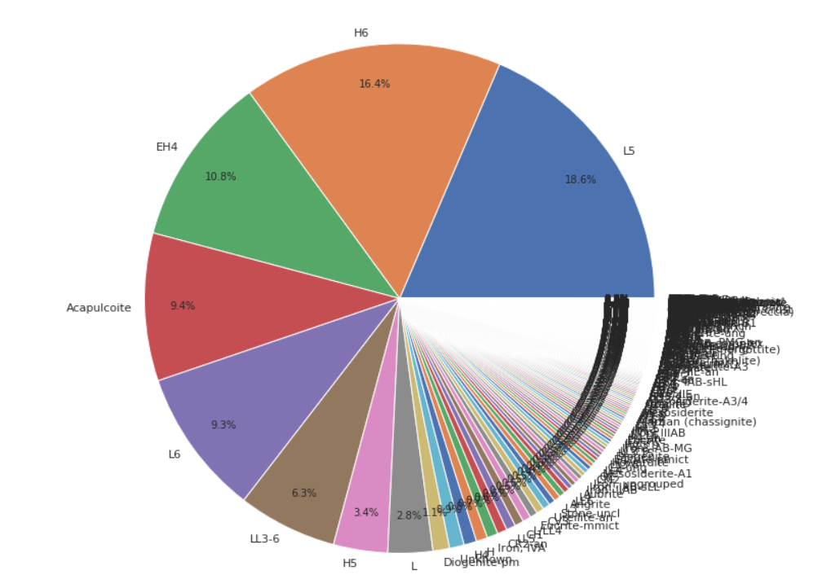
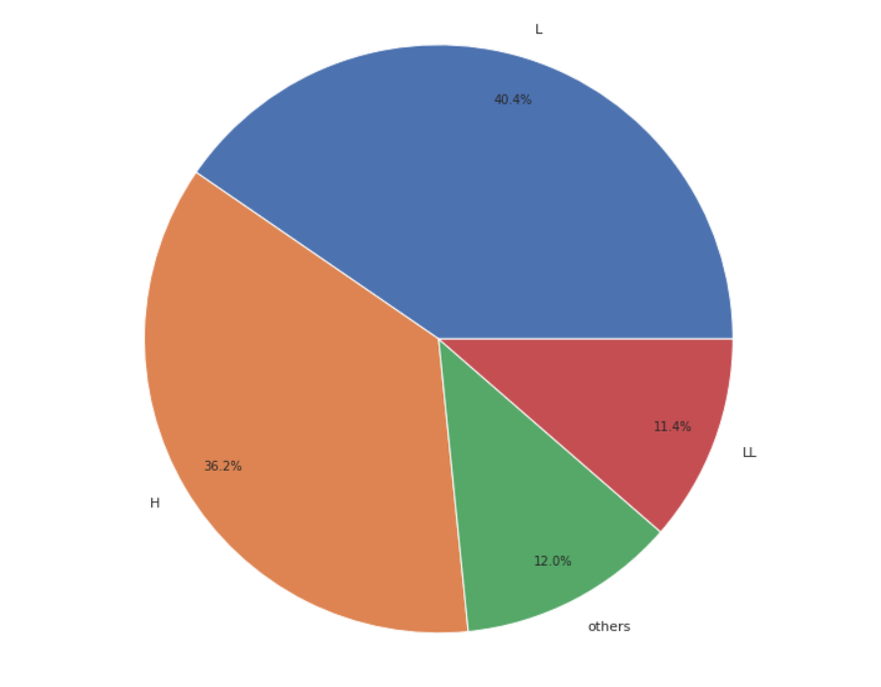
Visualizations on different meteorite classes
Before combining to common classes
After combining common classes
From the first pie chart, it is clear that significant part of the distribution is occupied by L and H class, which are part of Chondrite meteorites. Chondrite meteorite is the most common type of meteorite that falls to Earth.
Hence we redistribute the classes to L, LL,H and classify the remaining classes as others.

Slide 8
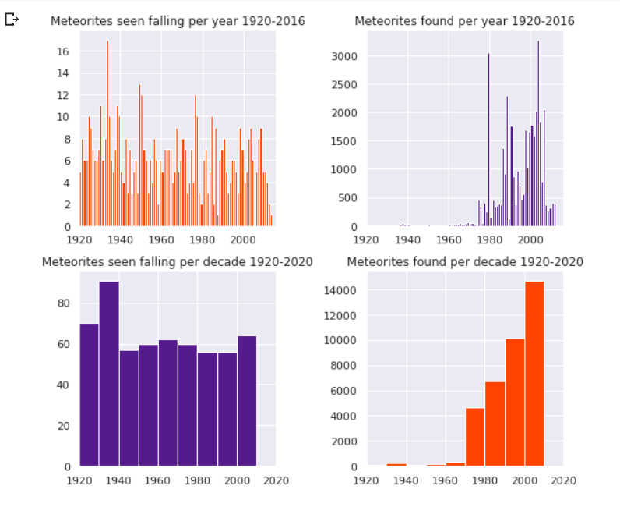
Analysis and visualizations on historical data
Inferences:
The distribution of number of meteorites found per year shows a steady rise. This trend can be attributed to the increase in world population.
The rising trend in meteorites found per decade can be attributed to the advancement in communication and observation technology.
The rate of meteorites seen falling over the last century is nearly constant, even with the rise in world population.
The number of meteorites seen falling is not affected by the rise in world technology and world population.

Slide 9
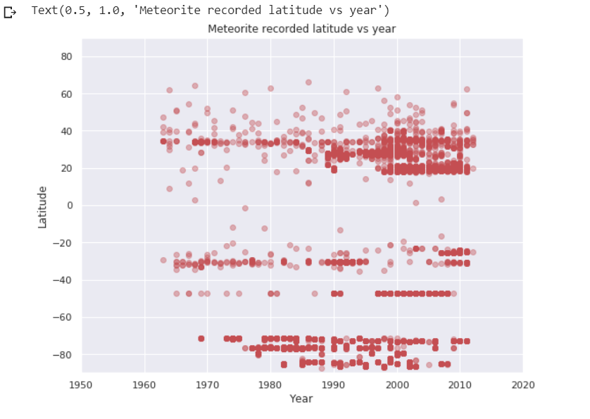
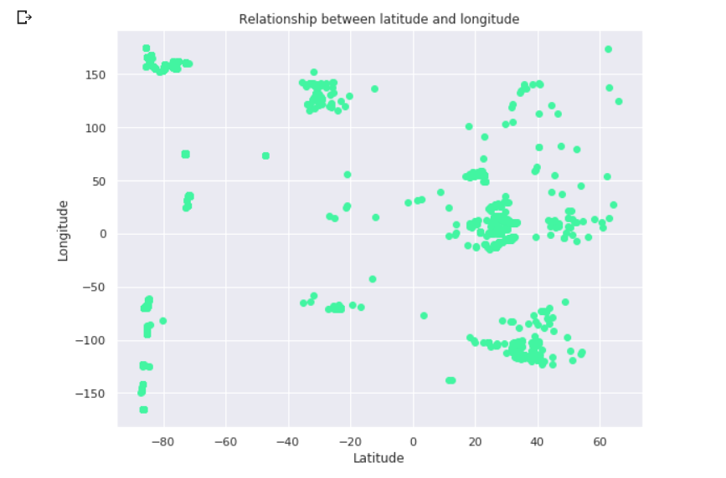
Correlation graph
The rate of meteorites seen falling over the last century is nearly constant, even with the rise in world population.
This can be explained by the increase in density, while having the same spread.
The correlation coefficient of latitude and year column is 0.335136. A positive coefficient signifies positive linear relationship between the columns
The spread of latitude and longitude follow no order.
The correlation coefficient of latitude and longitude column is -0.457904. A negative coefficient signifies negative linear relationship between the columns

Slide 10
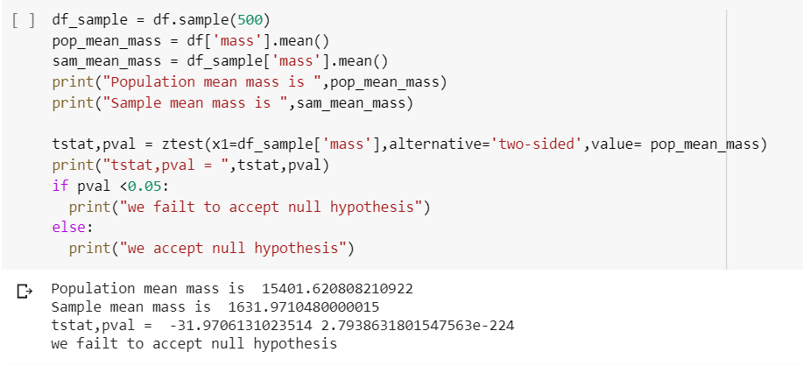
Hypothesis testing
H0: The difference between mean of sample mass and population mass mass is a statistical fluctuation.
H1: The difference between mean of sample mass and population mass mass is significant and not a mere case of statistical fluctuation.
We evaluate this two sided hypothesis test by taking a sample size of 500 from a population of 39210 rows.
THANK YOU

